Slide 1
WiFi Connected Drip Chamber
Anish Malladi
Arnold Wey
Gordon Macshane
Vishnu Kaimal
Yeonwoo Lee

Slide 2

The Problem
Low Fluid Levels
Overworked Staff
Delivery precision
The Aim
Enhancing hospital productivity

Slide 3
Targets and Trends
Hospitals and Homecare
Electronic Requisitioning System
Manufacturers and Distributors

Slide 4
Our Options
Pressure Sensor
Laser - Light Sensor
Probes

Slide 5

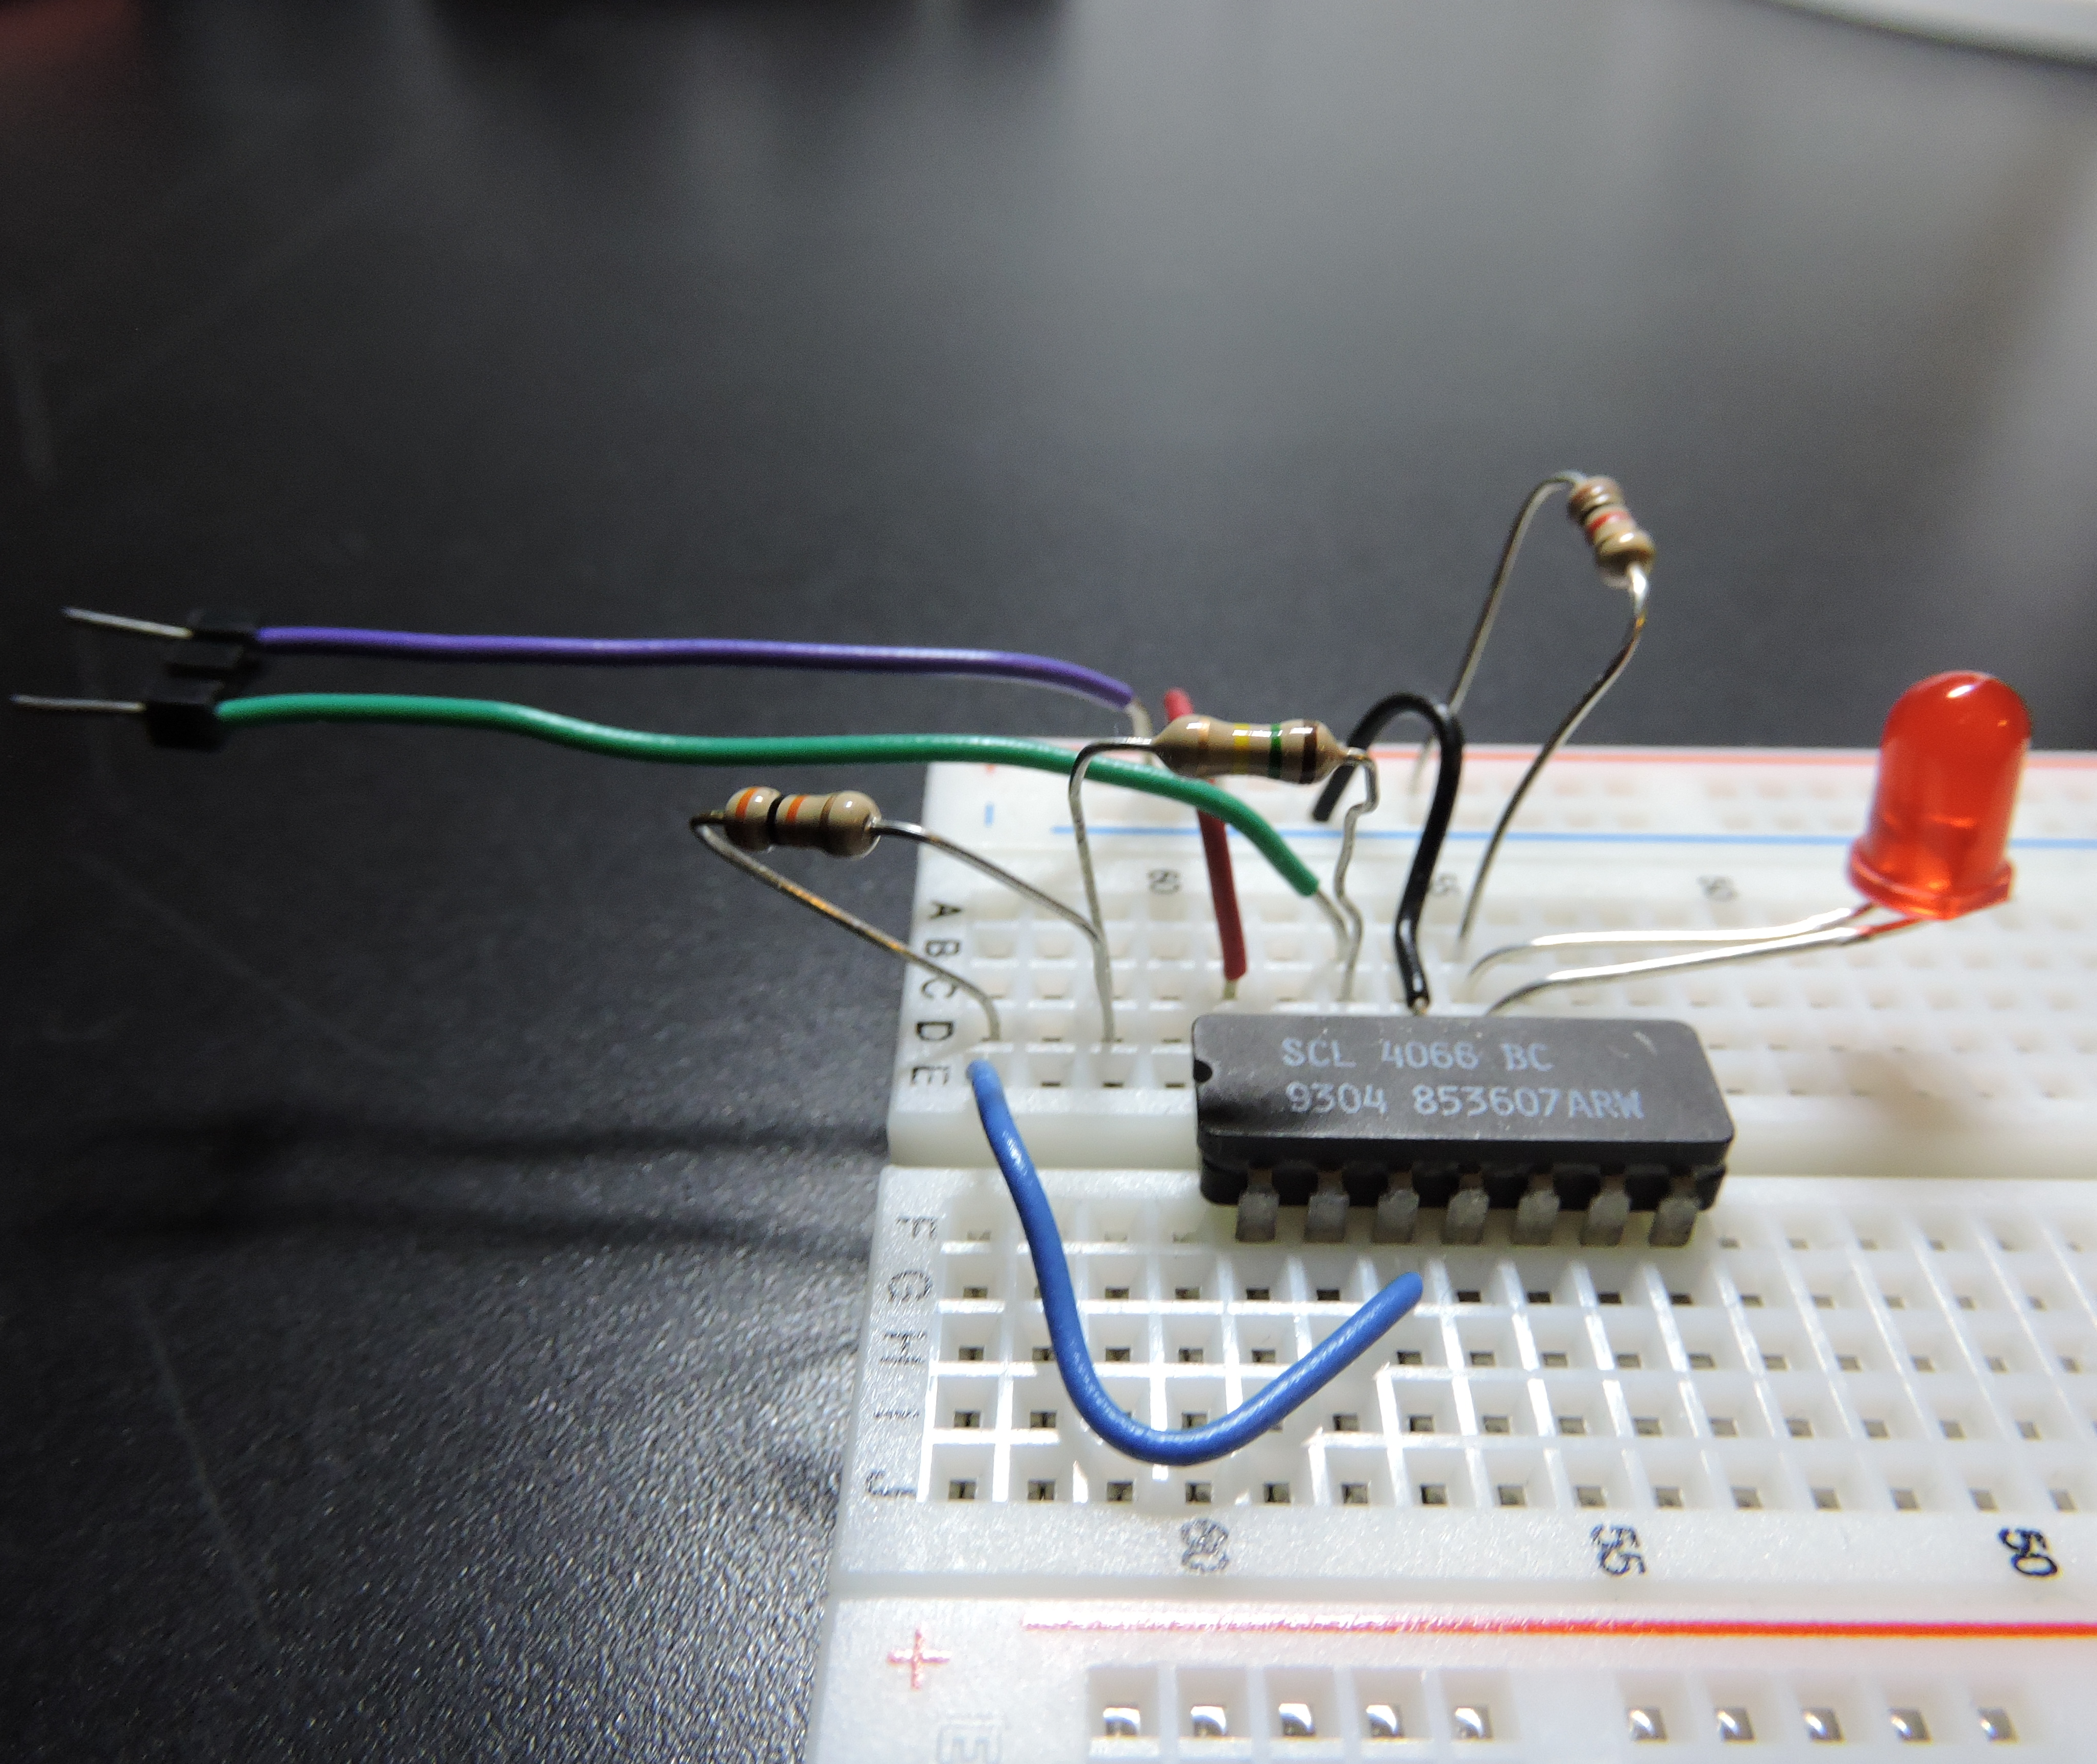
The Process
Build alongside circuit
Local Hospital feedback
Aesthetic Prototype

Slide 6
Possible Scaling
Backup system for faults
Aesthetics Design
Cost Oriented Design

Slide 7
Thank You.

